Slide 1
Restaurant Recommendation Expert System
Prepared By : Group-7
(IIT2017005 , IIT2017010 , IIT2017021 , IIT2017023 , IIT2017028 , IIT2017030 , IIT2017036 , IIT2017503)

Slide 2
Abstract
Restaurant recommendation system is a very popular service whose accuracy and sophistication keeps increasing every day.Recent years, recommender system has become an effective way to provide people with personalized and useful information.
Selecting the restaurant according to the rating and cost , filters out the restaurant and recommend according to that. This is the main factor considered in our system.

Slide 3
Introduction
Restaurant Recommendation Expert System is a rule-based expert system which primarily aims to suggest users the best food to eat in the given city based on their preferences. The application targets everyone who wishes to go to a restaurant to eat and have an outing.

Slide 4
Cont...
How the application actually works ?
The application takes the food preference into consideration to recommend food to the users. The system asks user some set of predefined set of questions and on the basis of the answer given by user. The recorded responses of the user updates the knowledge base. From this knowledge base CLIPS uses forward-chaining to infer the solution. Every time a rule is fired, it searches through the present knowledge base. If the conditional fact is present in the database it will assert a new fact in the database.

Slide 5
Literature Survey
Firstly there is always not available source of information and also limited to only those places they have visited before and there are chances of users of not liking the place recommended by their friends. Exploring new places according to your preference list will not be obtained.
Secondly , the information provided by the site can also be biased,thus the information provided cannot always consider being accurate.
So to solve these types of problems there are recommender systems widely used nowadays which recommends you the restaurant according to your needs and your preferences.

Slide 6
Cont...
In the past not much work is done in this field.We got hold of three recommender systems which are also doing similar work:
1. Gadget-Recommender system - Recommends gadget based on type, budget and brand preference of the user.
2. Flower-Identification System - Identifies flower’s name by taking properties such as type_of_soil, Plant_Height , Root_Type, Season etc. into consideration.
3. Animal-Identification System - Identifies animal’s name by taking some of its characteristics into consideration.

Slide 7
Novelty of Work
The aim of our project is to provide user list of some restaurants based on his/her preferences of city,veg/Non-veg, cuisine, budget and rating of the restaurant.
There was no restaurant recommendation project based on the frameworks of CLIPS as backend and Java as User Interface.Also the projects which were developed under this genre did not actually use the concept of Expert Systems but in our project, we have implemented proper Expert System Concept.

Slide 8
Novelty of Work..
The approach we have used provides easy updation, insertion and deletion of any restaurant in the database.
Our project lists all possible restaurants based on the user’s preferences by taking advantage of Forward Chaining capability of CLIPS

Slide 9
Background
Real Time Expert System
The restaurant recommendation expert system uses Rule-based recommendation technique for producing restaurant recommendations. Basically,recommendation engine it helps the users to find their preferences based on questions asked by the system.Recommendation systems solve these kind of problems by exploring the user preferences.Based on the user inputs, the inference engine fires the rules.
The CLIPS shell provides basic elements of the expert system.
Working memory : Has the fact-list, and instance-list.
Knowledge-base: Contains all the rules, the rule-base.
Inference engine: Controls overall execution of rules

Slide 10
2. Knowledge Base
The database includes local restaurants of allahabad and Lucknow which were added according to personal experiences and help from online sources. The data collected for each restaurant is stored in CSV which loads the rules for each restaurant upon execution of the program.

Slide 11
3. Inference Engine
Facts present in knowledge base are filtered according to rules in knowledge base we give output to the user.
Example if a person have five requirements for the restaurant he wanted to visit but only three of them are present in the location A and remaining two requirements in other location B then our inference engine will execute the priority rule in the knowledge base and gives the output as the A .

Slide 12
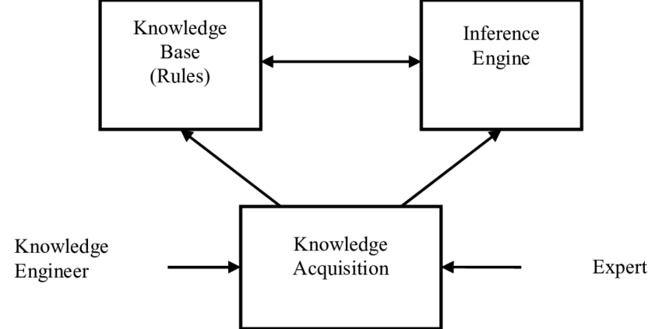

Slide 13
About Dataset
We have manually added the database for 2 cities i.e Allahabad and Lucknow. 29 restaurants in total are added in the database each having characteristic features as mentioned in the Restaurant Class. Same restaurant can serve both Veg and Non-veg , multiple Cuisines at the same time. However Rating and price range of each restaurant is fixed and cannot have multiple values simultaneously.

Slide 14
Tools & Techniques
Environmental Setup
The project can work on any general computer with Windows operating system. The only requirement is that the CLIPS Inference Engine should be installed in the system and java environment setup should be there in the system. JavaFX is used for GUI part , So the JavaFX module should be attached with the respective IDE. Path of the Dynamic-Link Library file of CLIPS JNI module(discussed in the following sections), should be provided in the System variable path. The jar file of CLIPS JNI should be provided in the library(lib) folder of the project.

Slide 15
Implemented Modules
CLIPS JNI
It stands for CLIPS Java Native Interface. CLIPS JNI demonstrates basic techniques for integrating CLIPS with a Java. CLIPS JNI also includes an Integrated Development Environment (IDE) for writing and debugging CLIPS programs.
JavaFX
JavaFX is the GUI library in Java. It provides many functions which is used to make a User-Interactive Environment very easily in a java program.

Slide 16
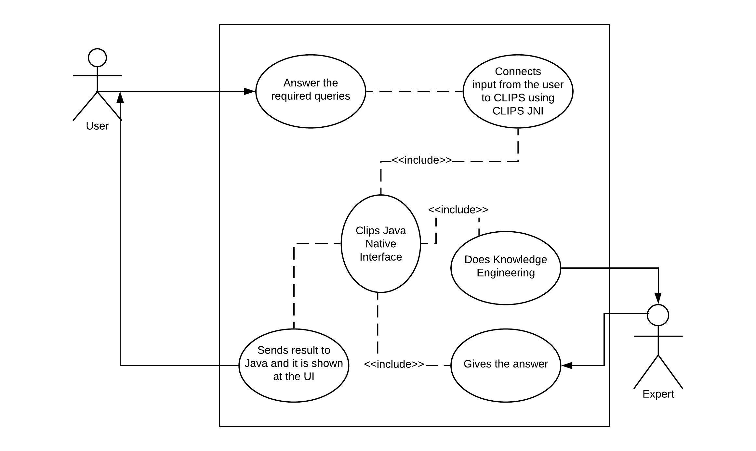
Use Case Diagram

Slide 17
Proposed Model / Framework
Quick View
User will interact through the GUI provided. Answers to different questions like location, cuisine, budget etc are to be provided by the user and after getting the answers to the required questions, the expert system will fire the rules and after inferencing from the knowledge base it will show all the restaurants that satisfies the given constraints.

Slide 18
Features
Following features are being provided in the system :
A graphical user interface ( GUI ) for the users to interact with the system for a better user experience.
Restaurant data can be easily added or updated by knowledge engineer.
Recommendation based on multiple factors, the specification of which is to be provided by the user.
Also shows enhanced recommendations that are of the best value for the same budget along with the recommendation exactly according to the given user preferences ( e.g if user asked for restaurant with certain rating then the system will also show restaurants with better rating for the same budget and other factors .

Slide 19
Field Description
Following fields are considered :
Location : The city in which the restaurant is located ( e.g Allahabad, Lucknow etc ).
Food Type : The type of food offered at the restaurant ( e.g Vegetarian, Non-Vegetarian ).
Cuisine : The food of different regions being offered by the restaurants ( e.g Indian, Italian, Chinese etc ).
Budget : The per person average price of the food at a particular restaurant ( e.g under 200 Rupees, over 300 rupees ).
Restaurant Rating : The rating of the restaurant according to 3 star Michelin Rating.

Slide 20
Working
We are taking input from the user through the graphical user interface ( GUI ) provided. These input is then sent to the CLIPS using CLIPS JNI where the Inference Engine fires and matches procedures and gives the result which is then sent to the Java Graphical User Interface using CLIPS JNI. The list of resultant restaurants is shown using list to the User Interface.
System Limitations
Limited and finite data set.
Limited cities are covered.
Only popular restaurants are covered.

Slide 21
Expert System Development Life Cycle

Slide 22
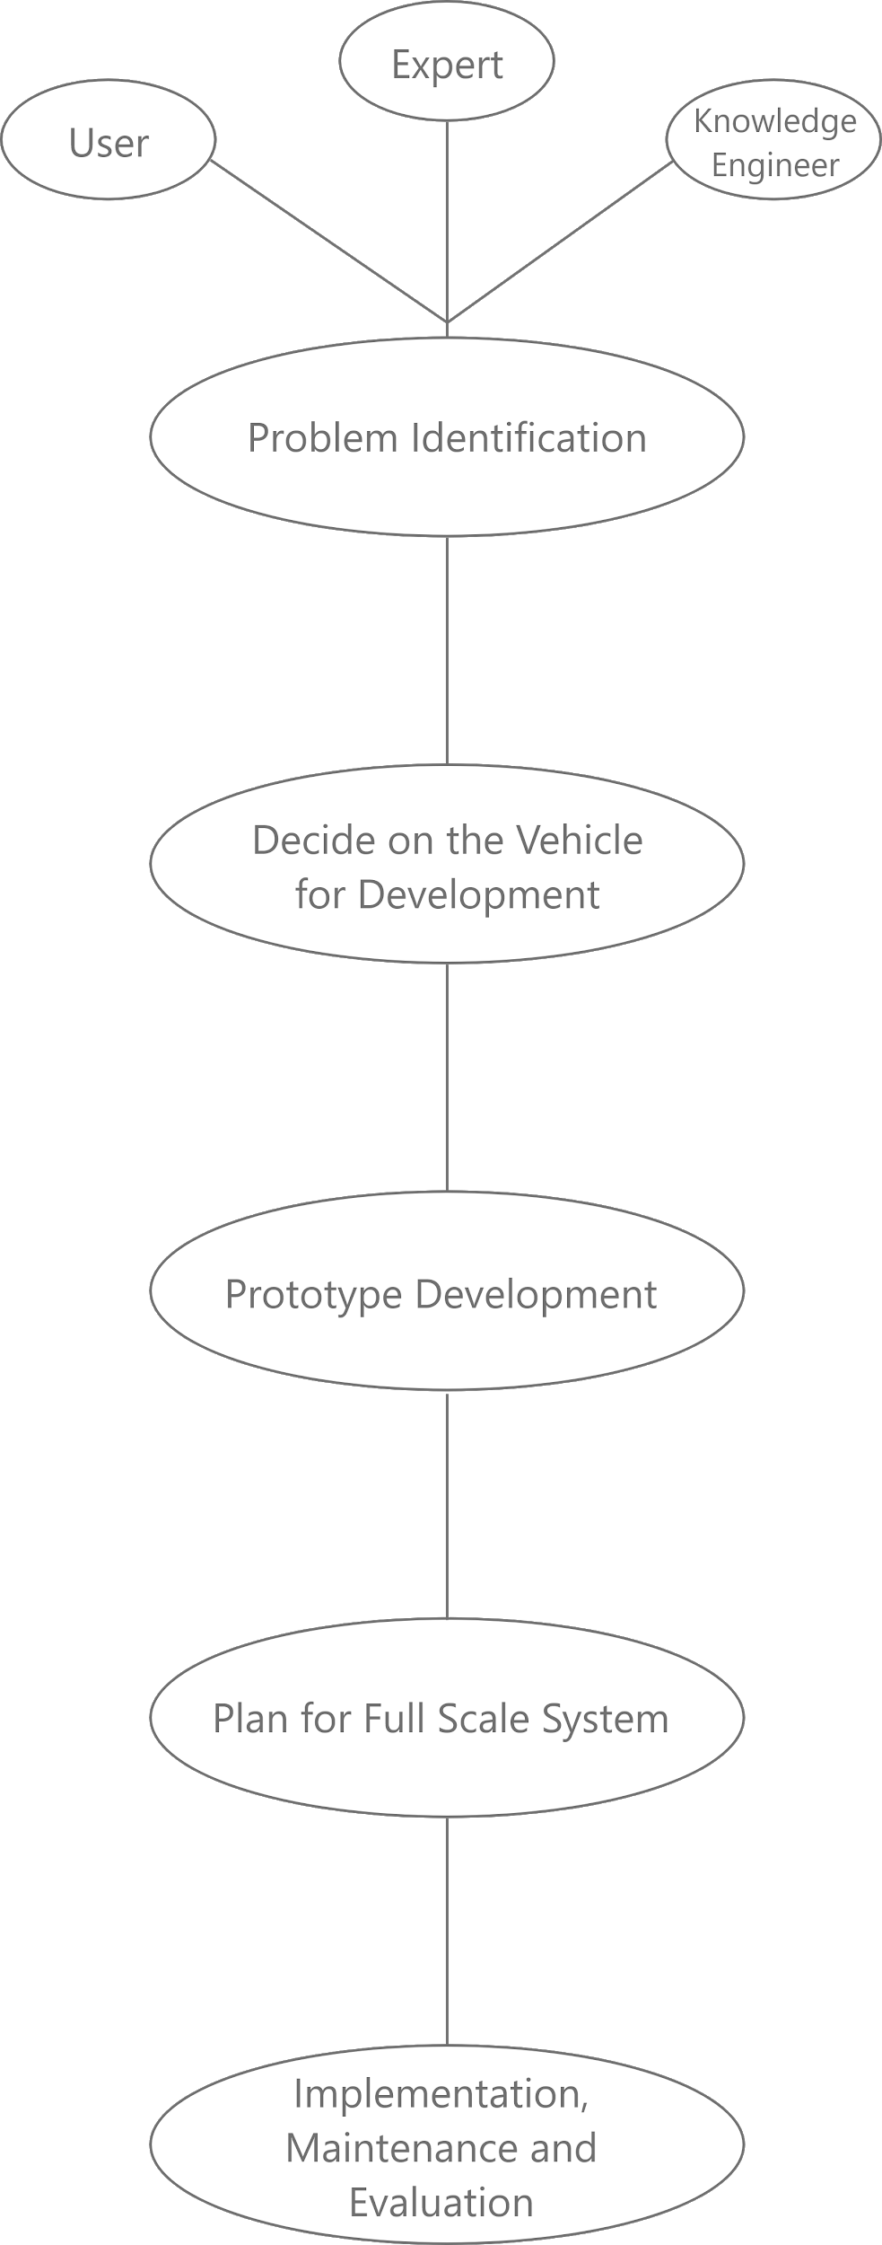
Flow Diagram

Slide 23
Result and Comparisons
Result of Proposed Model
We are taking input from the user and then sending it to the CLIPS using CLIPS JNI and then Knowledge Base comes into the rule.
Our Inference Engine does fire and match procedure and gives the result to and it is sent to the Java User Interface using CLIPS JNI. The list of resultant restaurants is shown using list to the User Interface.

Slide 24
Comparison with the Results of Existing Module
There are projects on Gadget Recommendation System,Flower Detection, Animal Detection and so many but not specifically on Restaurant Recommendation System using CLIPS. CLIPS Java Native Interface is also used which is quite complex when it comes to attaching it with the Java program for User Interface but at the same time, it is quite useful as well.
There are recommendation projects on CLIPS which shows only one result but here in this project , user can get multiple recommendations for the restaurant depending on the inputs provided by the user at the interface.

Slide 25
Conclusion with Future Scope
While making this project, all criteria for any particular restaurant is taken into consideration and it is observed that how much any criteria is important for any restaurant to classify it into a particular class.
Future Scope
We can use more criteria to get more filtered results in the list of resultant restaurants.
We can provide review system for the user for any particular restaurant and it can be used to get more enhanced result in future time.
We can provide more restaurants in our database with respective details about that restaurant. It can be more useful for the end-user because now he/she will have more options to choose from.

Slide 26
Thank you

